Slide 1
RESOLVING BIAS IN HYBRID RECOMMENDATION SYSTEM
Team Members:
Guide: Ms. S. ANANTHI, M.E.
Asst. Professor,
Sri Sairam Institute of Technology.
No. | Register number | Name
1. | 412413104017 | DANTHI.S.AKSHAY
2. | 412413104036 | M.KARTHIK
3. | 412413104065 | S.RAGHUL

Slide 2
Abstract
Recommender systems are information filtering systems that predicts “preference” or “rating” of the user.
It generates personalized predictions based on the user ratings.
In the past two years, we have created more data than ever.
This abundance of choice causes a problem.

Slide 3
Rating metrics are of two types: Explicit feedback or Implicit Feedback. Explicit feedback is of numerical scale from 1 to n. example: 1 to 5 whereas, Implicit feedback is binary, example: like or dislike.
Simpson’s Warning:
“less conditioning is most likely to lead to serious bias when Simpson’s paradox appears”

Slide 4
The objective is to incorporate an algorithm that removes the bias from recommendation algorithm.
Data without proper pooling leads to incorrect recommendations and ignoring potential recommendations.
This can be solved by multi-resolution technique.
Multi-resolution technique pools the incorrect data accurately.

Slide 5
Existing systems and methods
The existing approaches for recommender systems include
Collaborative filtering
Content-based recommendations
Hybrid approaches

Slide 6
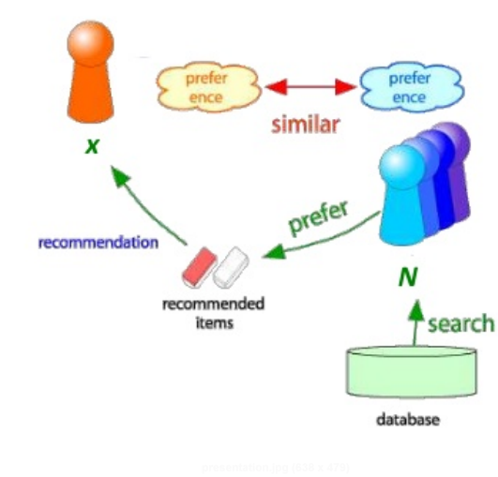
Collaborative filtering
Filters information by using recommendations of other users.
“Users who agreed in their evaluation of certain items in the past are likely to agree again in future”.
Working:
-> Consider user ‘X’
-> Find set N of other users whose
ratings are ‘similar’ to X’s ratings
-> Estimate X’s rating based on
ratings of users in N

Slide 7
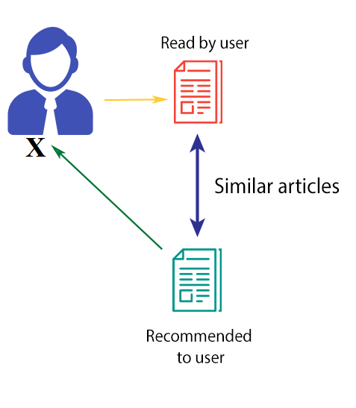
Content based filtering
Systems recommending items similar to items a user liked in the past.
Does not require data of other user profiles like in collaborative filtering.
-> Consider user ‘x’
-> Recommend items to x based
on previous items x liked
Provides personalized suggestions
for individual users.

Slide 8
Hybrid recommender systems
A new system without collaborative user and item data, the collaborative filtering approach cannot generate predictions(cold start).
A system without content information, the content-based approach will fail to recommend.
To overcome the principal limitations, hybrid systems have been developed.
Hybrid approach allows to combine the best features of both CB and CF systems.
Combines multiple recommendation techniques together to produce its output

Slide 9
Limitations:
Information overload:
As more and more rapidly changing information becomes available, individuals are not able to rely on old data to make decisions.
Biases:
Much variation of ratings is due to effects associated with either items or users, independently of their interactions
Some users tend to give higher/lower ratings than others
Some items tend to receive higher/lower ratings than others

Slide 10
Explicit Selection Bias:
- In recommender systems that employ an explicit feedback system, that is, a scale of 1 to 5 to rate a product, one interesting observation in user behavior was that some users had a tendency to view rating in binary such that they either rated 5 for a movie they liked and 1 for a movie they didn’t.
- Hence, this behavior resulted in bias due to high frequency of extreme negative and positive reviews which in turn resulted in bad recommendations.

Slide 11
Proposed System:
Our algorithm aims to reduce the significant bias that occurs during the prediction phase of the Recommender System.
It uses multiresolution techniques, where the data is properly classified, where the absolute ratings and the relative ratings of the items are considered.

Slide 12
Advantages:
Reduced Bias: The bias occurring in predictions is considered and resolved to give a unbiased prediction result.
Faster algorithm:
The algorithm was made faster by making it programmatically faster.

Slide 13
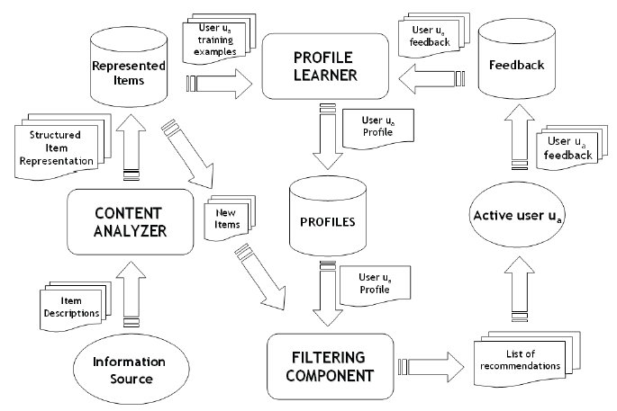
Diagram: (Hybrid Recommender System)

Slide 14
List of Modules:
1. Standard Hybrid Recommendation System(old_recom()):
Hybrid Recommendation algorithm without considering bias.
predict_topk(): recommendations based on top-k similar users.
2. Bias Resolved Hybrid Recommendation(bias_less_recom()):
Hybrid Recommendation algorithm removing explicit selection bias.
predict_topk_nobias(): recommendations by eliminiating explicit selection bias.
3. Performance Evaluation Metrics:
Calculation of MSE.
get_mse(): compares deviation between predicted and actual test user-item interaction matrix.

Slide 15
Algorithms:
creating similarity matrix:
ratings.size = np.zeros(n_users, n_items)
ratings[user_id, item_id] = rating
generating test data:
test = train.nonzero(), size=threshold/2
train = ratings - test
cosine similarity:
if kind == 'user':
return similarity.dot(ratings) / np.array([np.abs(similarity).sum(axis=1)]).T
elif kind == 'item':
return ratings.dot(similarity) / np.array([np.abs(similarity).sum(axis=1)])
predict_topk:
for i in xrange(ratings.shape[0]):
top_k_users = [np.argsort(similarity[:,i])[:-k-1:-1]]
for j in xrange(ratings.shape[1]):
pred[i, j] = similarity[i, :][top_k_users].dot(ratings[:, j][top_k_users])
pred[i, j] /= np.sum(np.abs(similarity[i, :][top_k_users]))

Slide 16
predict_topk_nobias():
user_bias = ratings.mean(axis=1)
ratings = (ratings - user_bias[:, np.newaxis]).copy()
for i in xrange(ratings.shape[0]):
top_k_users = [np.argsort(similarity[:,i])[:-k-1:-1]]
for j in xrange(ratings.shape[1]):
pred[i, j] = similarity[i, :][top_k_users].dot(ratings[:, j][top_k_users])
pred[i, j] /= np.sum(np.abs(similarity[i, :][top_k_users]))
pred += user_bias[:, np.newaxis]
pearson_coefficient():
item_correlation = 1 - pairwise_distances(train.T, metric='correlation')
item_correlation[np.isnan(item_correlation)] = 0
get_mse():
pred = pred[actual.nonzero()].flatten()
actual = actual[actual.nonzero()].flatten()
return mean_squared_error(pred, actual)

Slide 17
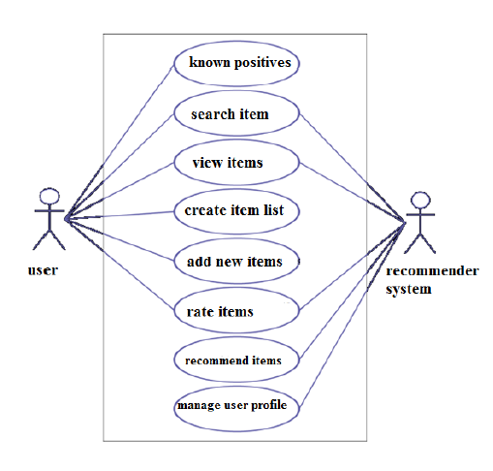
UML:

Slide 18
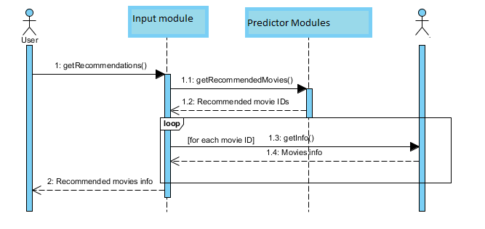

Slide 19
Input:
The MovieLens data set is the input our algorithm uses.
This data set consists of:
* 100,000 ratings (1-5) from 943 users on 1682 movies.
* Each user has rated at least 20 movies.
* Simple demographic info for the users (age, gender, occupation, zip)

Slide 20
The dataset
u.data -- The full u data set, 100000 ratings by 943 users on 1682 items. Each user has rated at least 20 movies. Users and items are numbered consecutively from 1. The data is randomly ordered. This is a tab separated list of user id | item id | rating | timestamp. The time stamps are unix seconds since 1/1/1970 UTC
u.info -- The number of users, items, and ratings in the u.data set.
u.item -- Information about the items (movies); this is a tab separated list of movie id | movie title | release date | video release date | IMDb URL | unknown | Action | Adventure | Animation | Children's | Comedy | Crime | Documentary | Drama | Fantasy | Film-Noir | Horror | Musical | Mystery | Romance | Sci-Fi | Thriller | War | Western | The last 19 fields are the genres, a 1 indicates the movie is of that genre, a 0 indicates it is not; movies can be in several genres at once. The movie ids are the ones used in the u.data data set.
u.genre -- A list of the genres.
u.user -- Demographic information about the users; this is a tab separated list of user id | age | gender | occupation | zip code The user ids are the ones used in the u.data data set.
u.occupation -- A list of the occupations.

Slide 21


List of Processes:
cosine_similarity():
A common distance metric is cosine similarity. The metric can be thought of geometrically if one treats a given user's (item's) row (column) of the ratings matrix as a vector. For user-based collaborative filtering, two users' similarity is measured as the cosine of the angle between the two user’s vectors
collaborative_filtering():
we predict that a user's u's rating for item ii is given by the weighted sum of all other users' ratings for item ii where the weighting is the cosine similarity between the each user and the input user u

Slide 22

predict_no_bias():
Certain users may tend to always give high or low ratings to all movies. One could imagine that the relative difference in the ratings that these users give is more important than the absolute rating values.
Subtracting each user's average rating when summing over similar user's ratings and then add that average back in at the end. Mathematically, this looks like

Slide 23
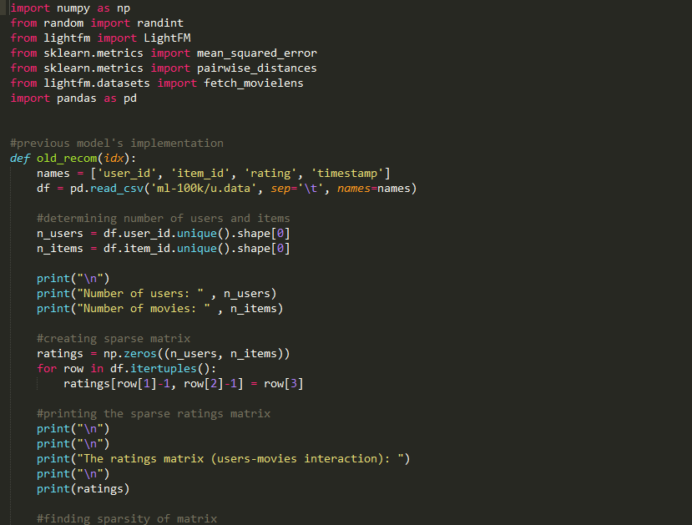
Code:

Slide 24
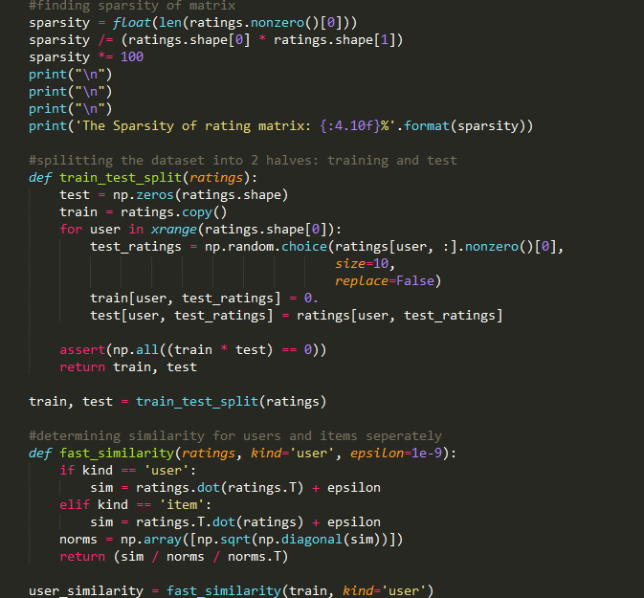

Slide 25
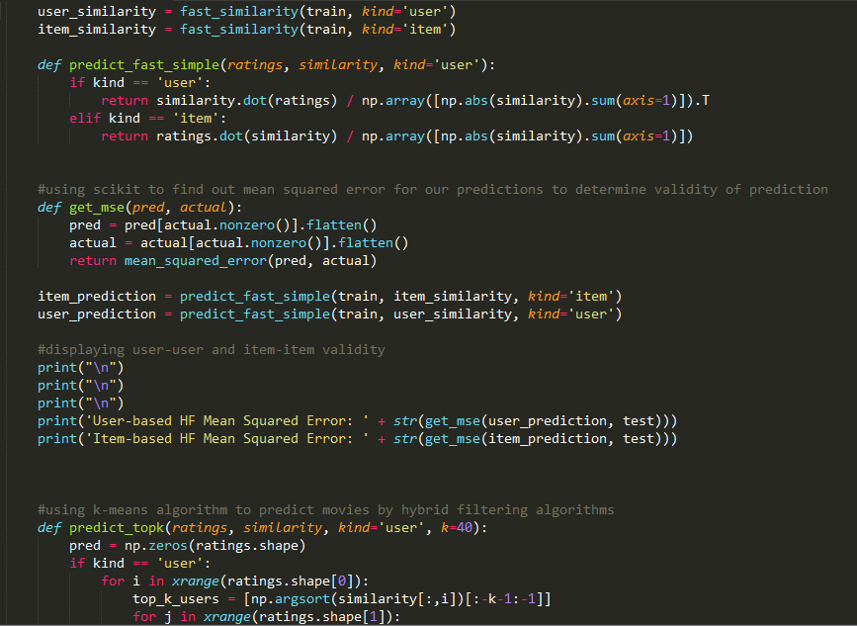

Slide 26
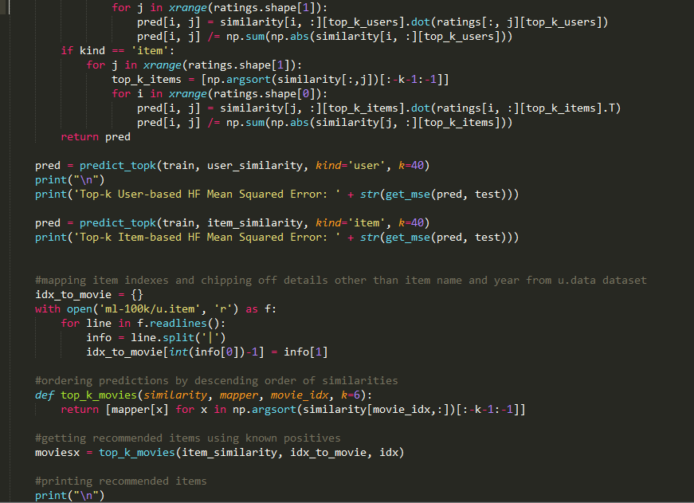

Slide 27
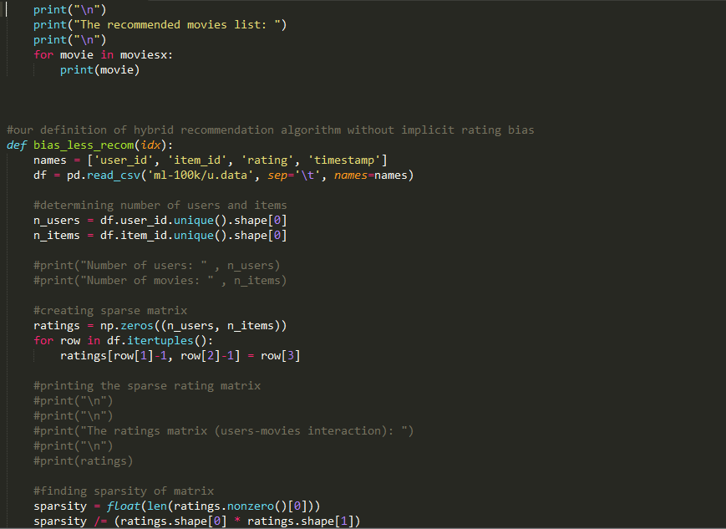

Slide 28
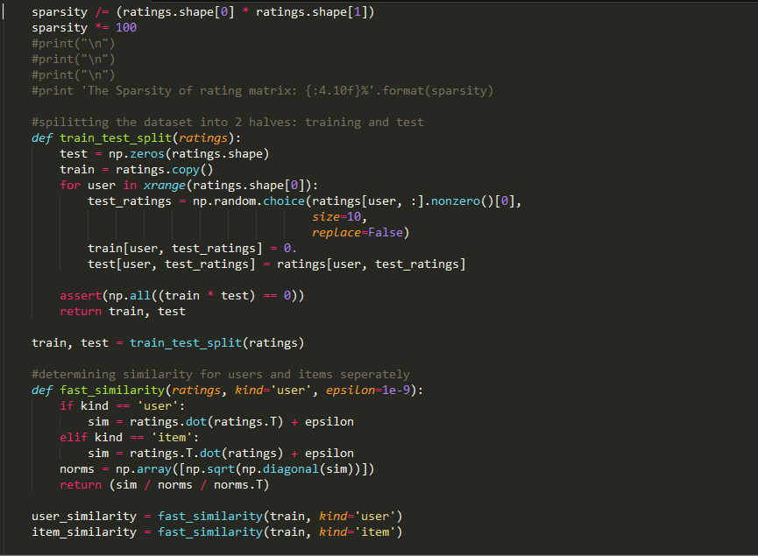

Slide 29
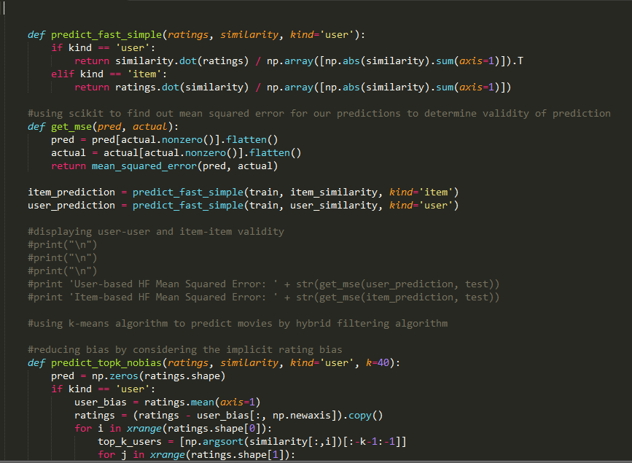

Slide 30
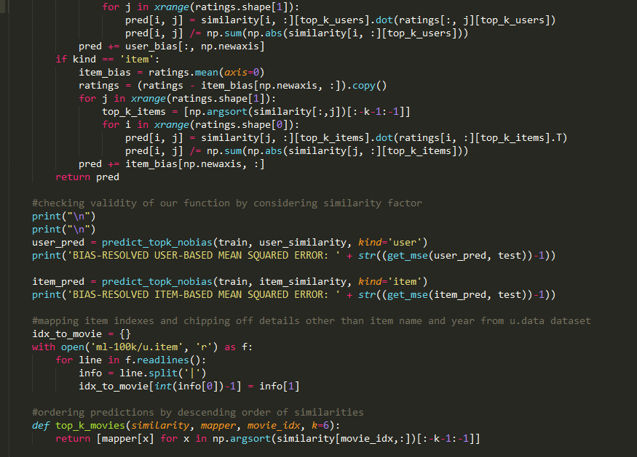

Slide 31
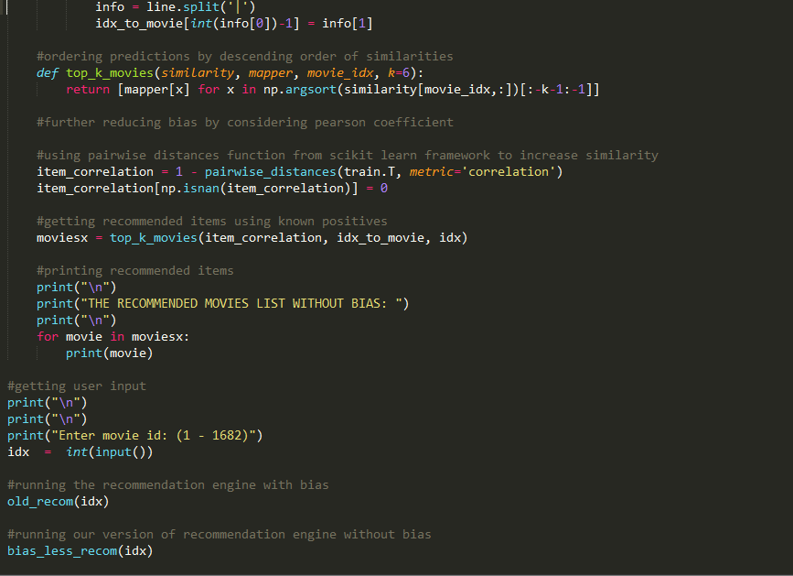

Slide 32
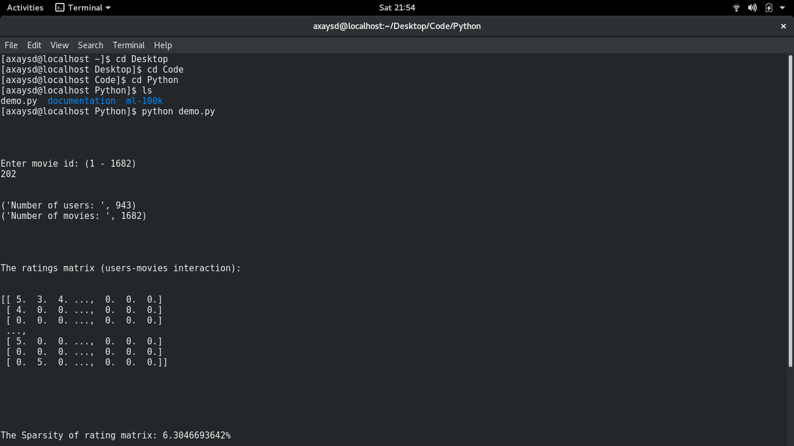
Output screenshots:

Slide 33
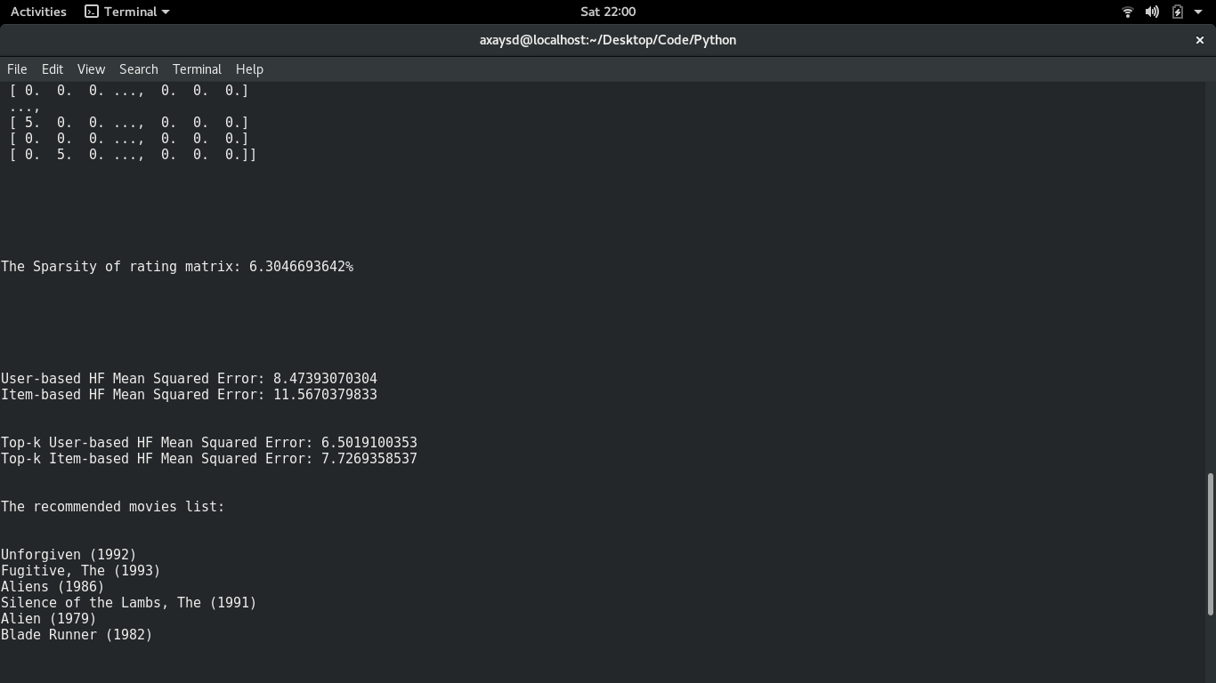

Slide 34
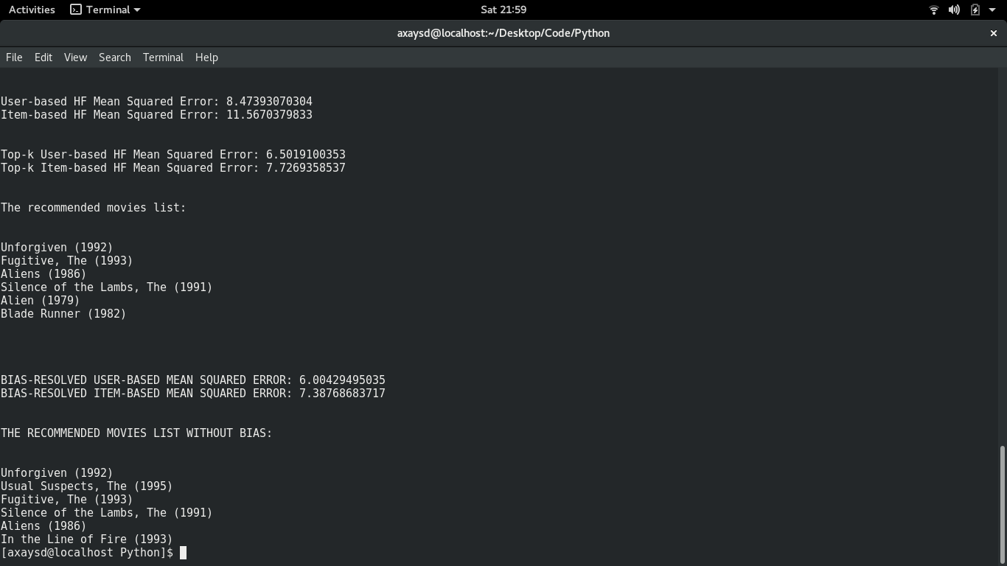

Slide 35
Work completed and further enhancements to be considered:
So far, the hybrid recommendation system without explicit selection bias has been implemented successfully.
Visualizer function to measure the deviance to be implemented.
A GUI interface using python’s tkinter framework is to be implemented.

Slide 36
Any queries?

